Slide 1
LabChat
Hanna Schulze, Oliver Wagner
Cloud Computing WS 18/19

Slide 2
LabChat
Agenda
Registering Users and Login Process
Face Recognition
Security aspects
Live Demo
Hanna Schulze, Oliver Wagner //Cloud Computing WS 18/19

Slide 3
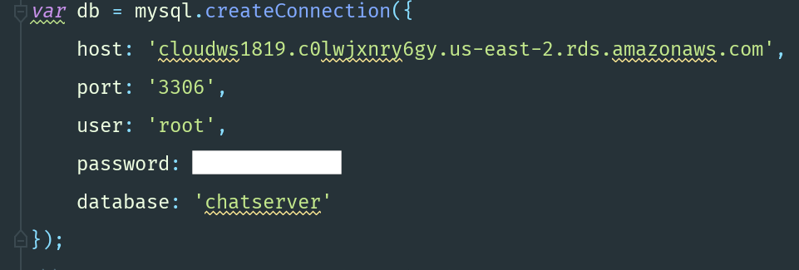
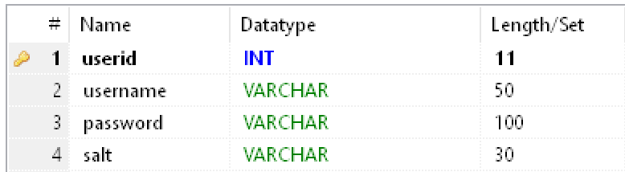
Registering Users and Login Process
MySQL DB hosted at AWS RDS
mysql-Node-Plugin
Saving unique User-ID, username, salted password hash and salt

Slide 4
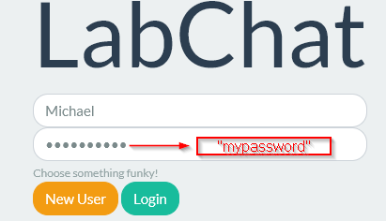
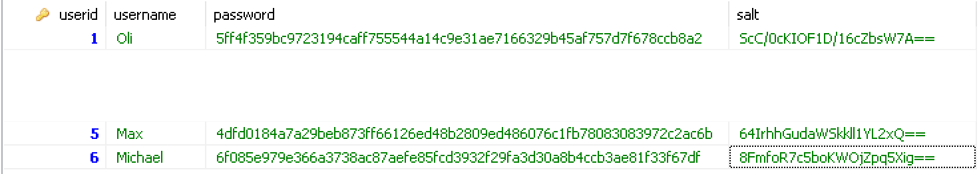
Registering Users Process
‚New User‘
INSERT INTO Users … password = SHA2(?, 256) ? = saltedPassword
salt = 8FmfoR7c5boKWOjZpq5Xig== saltedPassword = 8FmfoR7c5boKWOjZpq5Xig==mypassword

Slide 5

Login Users Process
‚Login‘
SELECT COUNT (*) FROM Users WHERE … password=SHA(?,256) ? = saltedPassword
count > 0
salt = 8FmfoR7c5boKWOjZpq5Xig== saltedPassword = 8FmfoR7c5boKWOjZpq5Xig==mypassword

Slide 6
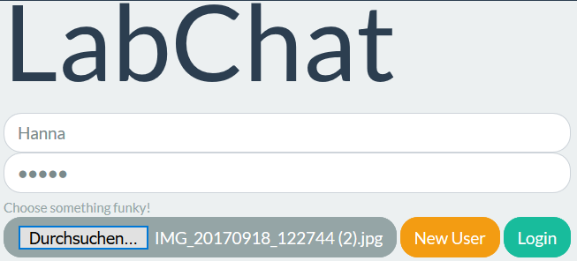
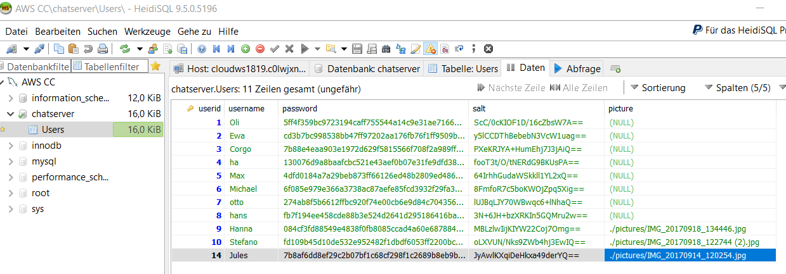
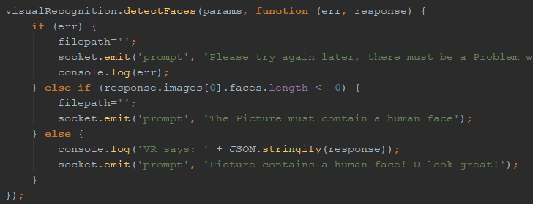
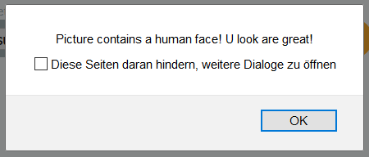
Face Recognition
Visual Recognition
if (response.image[0]faces.lenght >= 0)

Slide 7
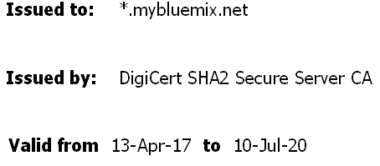


Security aspects: TLS
Before: Node server speaking HTTPS with self-signed certs / Lets Encrypt
But: Bluemix-Proxy only talking HTTP to applications, while speaking itself HTTPS to the outside world
Therefore
Making Node server speak HTTP again to the Bluemix-proxy
Make Node server trust proxies
On HTTP request, redirect to HTTPS
LabChat
HTTP
HTTPS

Slide 8
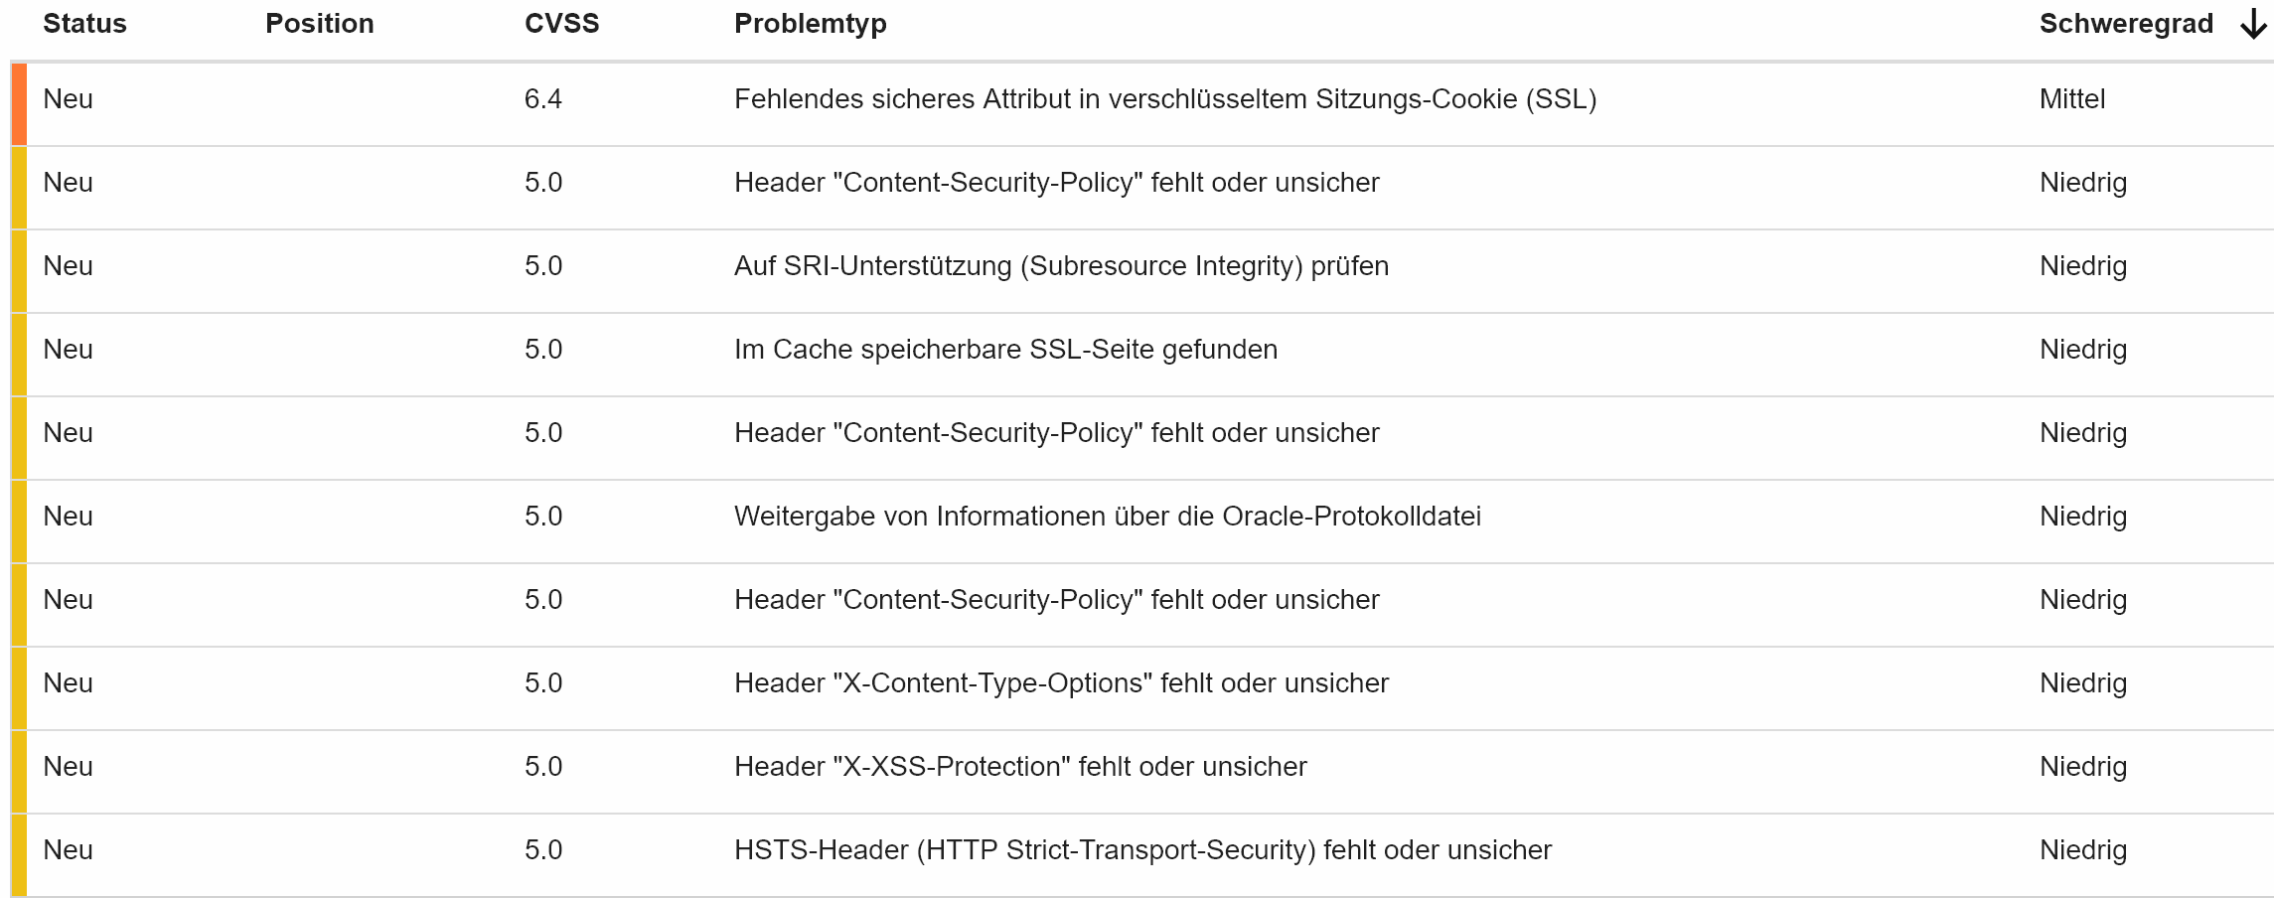
Security aspects: IBM AppScan

Slide 9
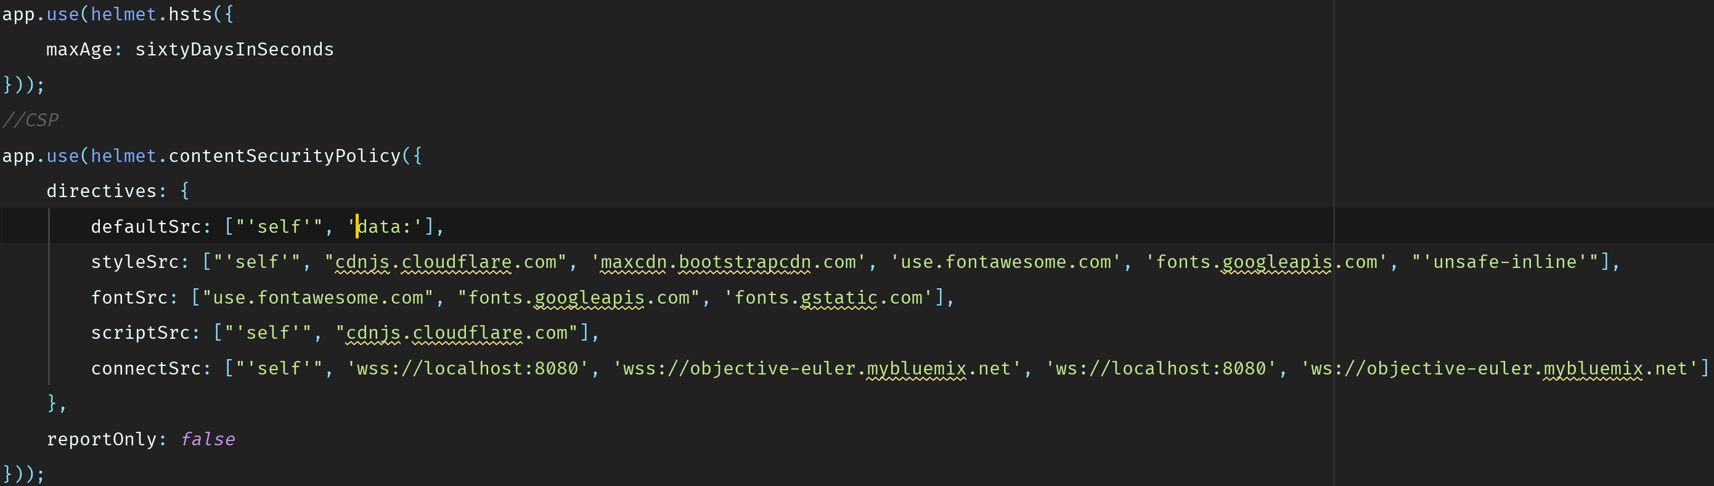
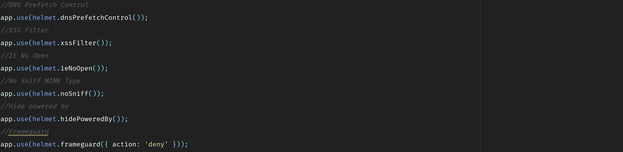
Security aspects: IBM AppScan

Slide 10

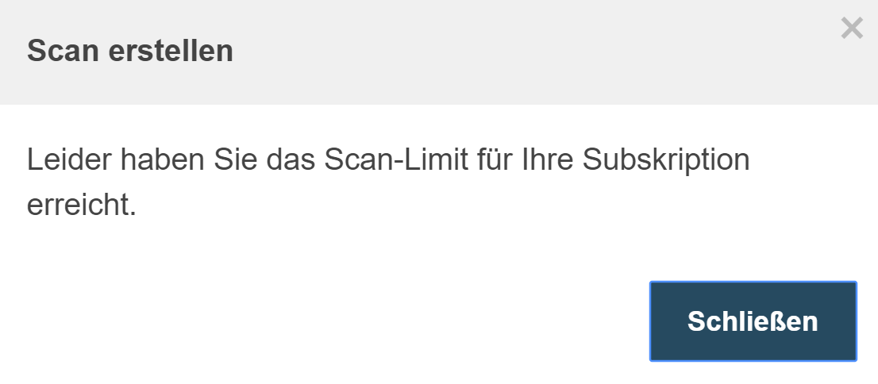
Security aspects: IBM AppScan

Slide 11
Lesson learnt
Connecting cloud services
Connecting a CloudSQL database with a Node application, sending and receiving data from and to the database
Using deprecated cloud services can be tricky
Security flags and headers are crucial for running a web applications safely

Slide 12
LabChat
Live Demo
https://objective-euler.mybluemix.net/
Hanna Schulze, Oliver Wagner //Cloud Computing WS 18/19

